Slide 1
CHALLENGE "0" :
What's your current version ?

Slide 2

TOPIC 1: TOP-DOWN APPROACH
Top-down approach is a method in which you start with the big picture of a problem. You will consider the overall and figure out the specific details shall be focus on. For example, it's like looking at a map and choosing all shortest routes

Slide 3

TOPIC 1: TOP-DOWN APPROACH
I will observe what the main problem of the assignment is, then divide it into separate parts and begin solving them one by one

Slide 4
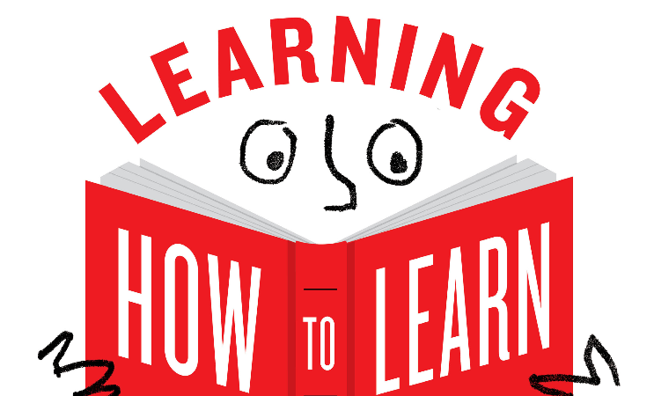
TOPIC 2: LEARNING HOW TO LEARN AND LEARN FAST
Learning how to learn is about optimizing the learning progress through various methods like time management, note-taking and more
Its goal is to learn something deeply and lastingly. It can help you have more autonomy and develop problem solving skill

Slide 5
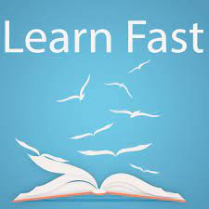
TOPIC 2: LEARNING HOW TO LEARN AND LEARN FAST
Learning how to learn fast is about understading the material, acquiring skills in a short time. It may not help you learn something deeply and lastingly like learning how to learn
Learn fast is suitable for people need to learn something quickly

Slide 6

TOPIC 3: AUTONOMY AT WORK
Autonomy at work means give people the right to decide how they work from the pace to when and where they do their work

Slide 7
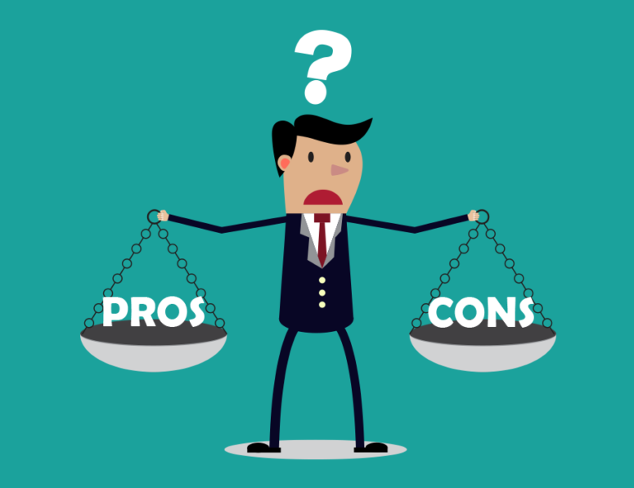
TOPIC 3: AUTONOMY AT WORK
Autonomy at work can create a positive environment, reduce stresses, boost creativity and productivity, many other advantages
It have many benefits but there is no thing should be too much, it may cause chaos, reduce work efficiency,...

Slide 8

TOPIC 4: SMART QUESTION
What's a smart question ? It's a question that has a clear, easy-to-understand , possible and relevant goal and the answer should be measurable

Slide 9
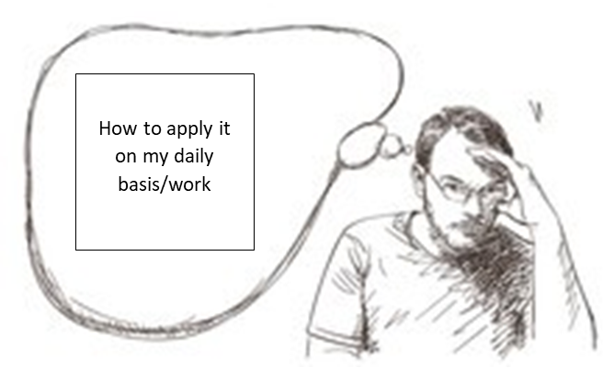
TOPIC 4: SMART QUESTION
On a daily basis, smart question can be used for many things. For example, asking yourself "how should i plan for my timetable ?"and answering it is quite helpful
As a part of daily work, asking yourself "what's main goal of it ? " and "how can i approach it ?" can provide you a clear direction on how to process

